Slide 1
Rockbuster
February 2025
Hannah Strassmann

Slide 2
Objective
Rockbuster Stealth LLC is a movie rental company that used to have stores around the world. Facing stiff competition from streaming services such as Netflix and Amazon Prime, the Rockbuster Stealth management team is planning to use its existing movie licenses to launch an online video rental service in order to stay competitive.

Slide 3
Bussiness Questions
In order to answer some of Rockbuster’s question some analysis have been made. In the following, the questions
Where are the most Rockbuster customers based
Where are the customers with the highest revenue based
How long are films usually rented for
will be answered.

Slide 4
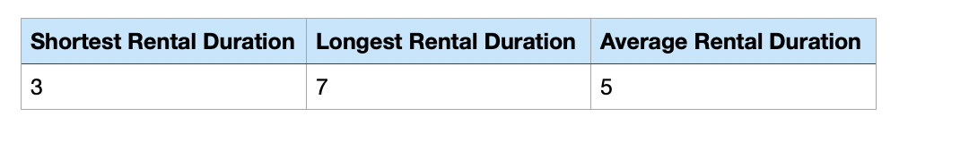
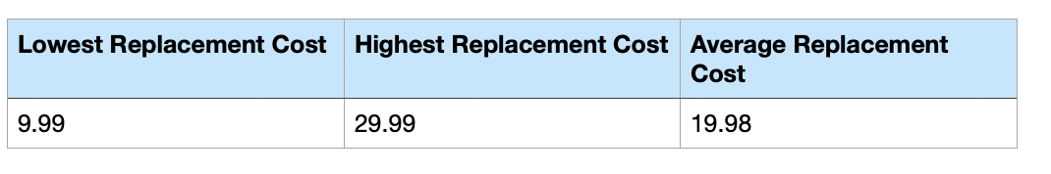
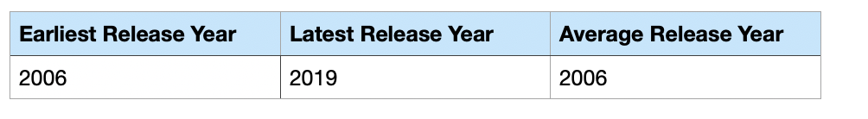
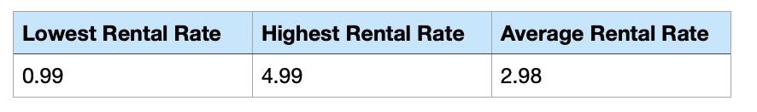
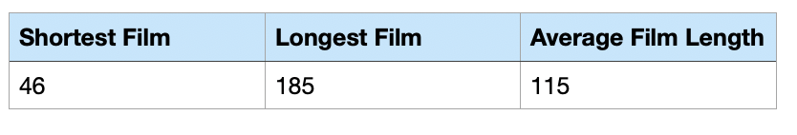
Exploratory Data Analysis
Rental Duration
Replacement Cost
Release Year
Rental Rate
Film Length

Slide 5
Rental Length Take Away
Films are not usually rented for more than a week but also rarely for just a day.

Slide 6
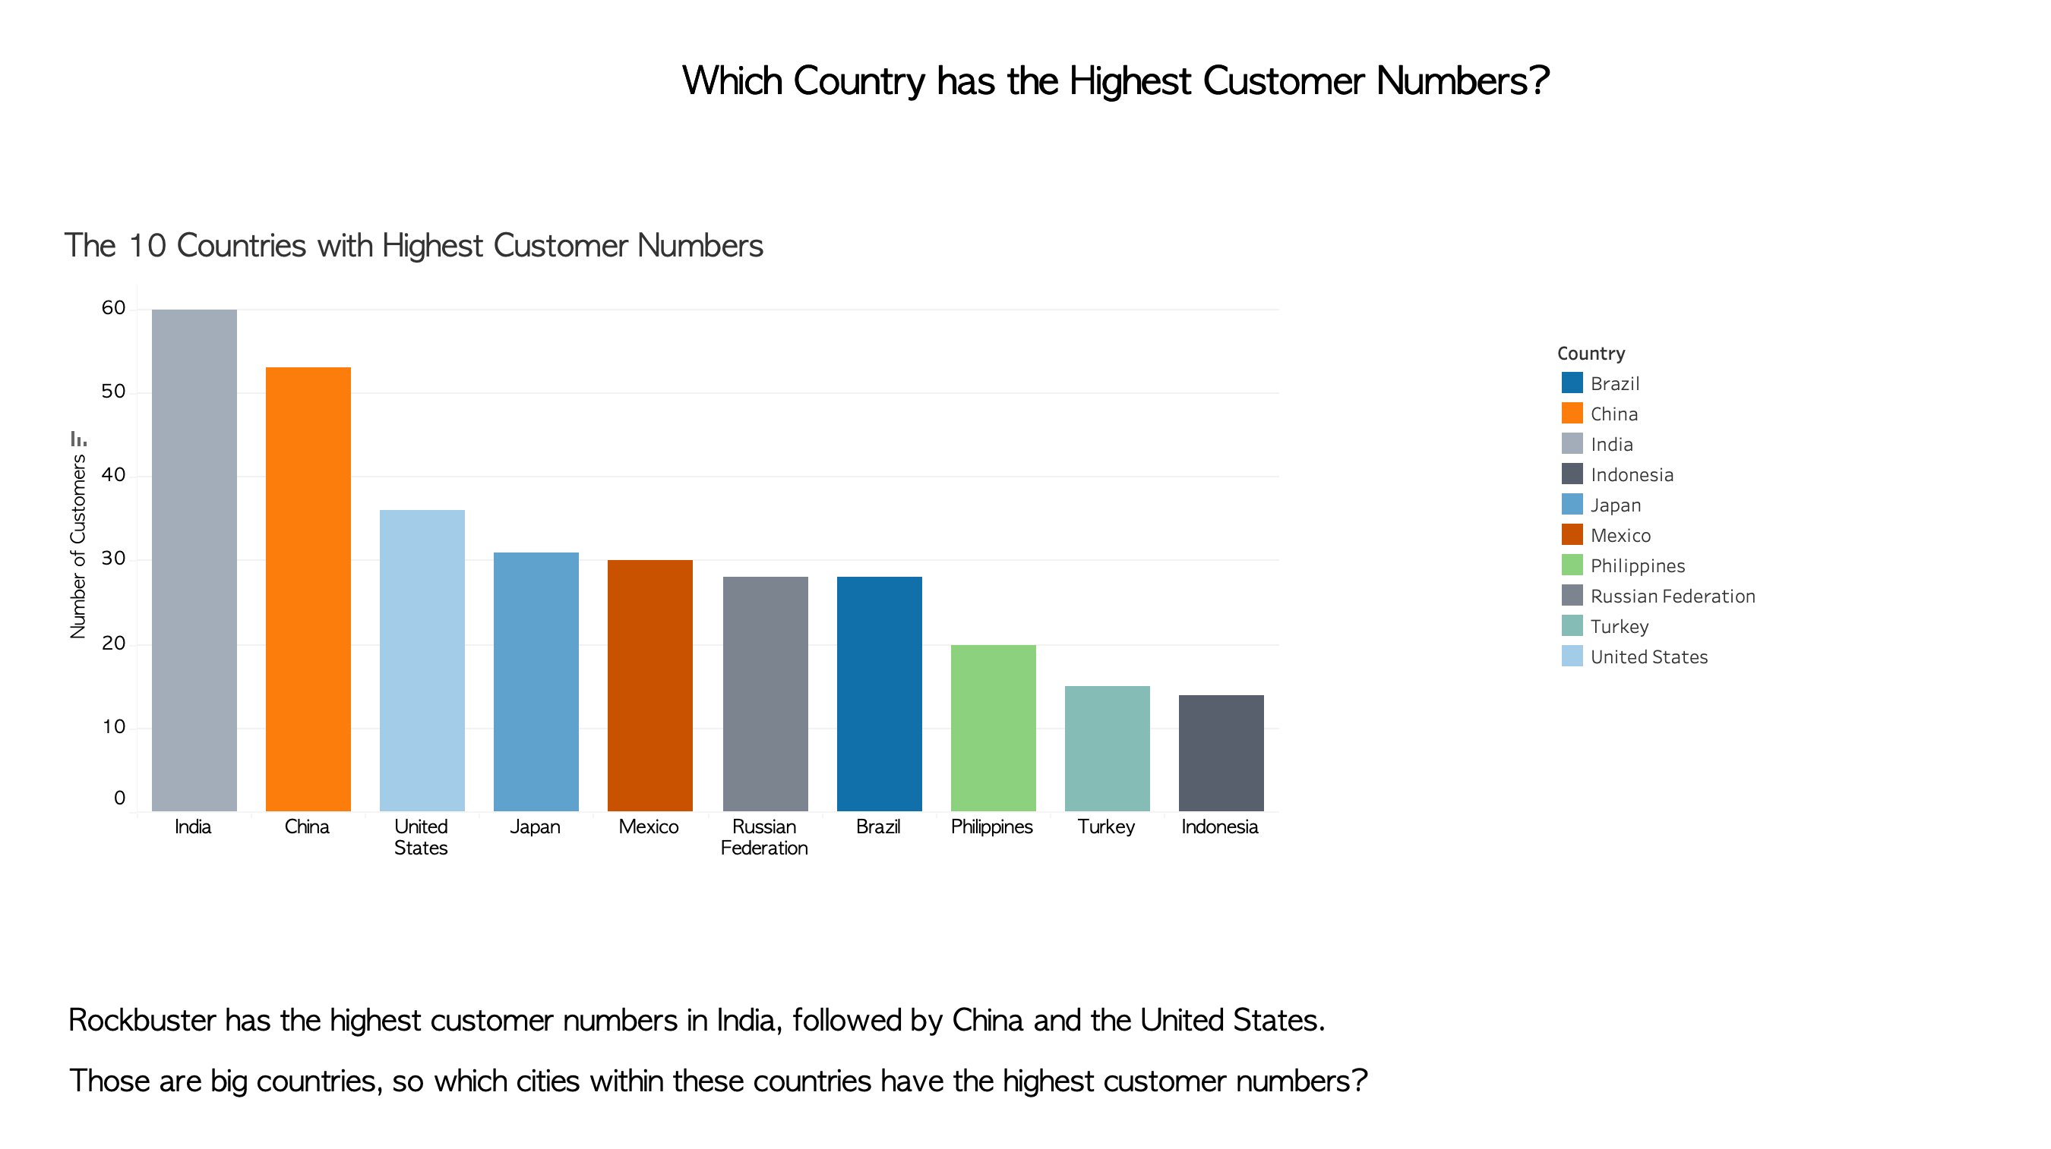
Which Country has the Highest Customer Numbers?

Slide 7
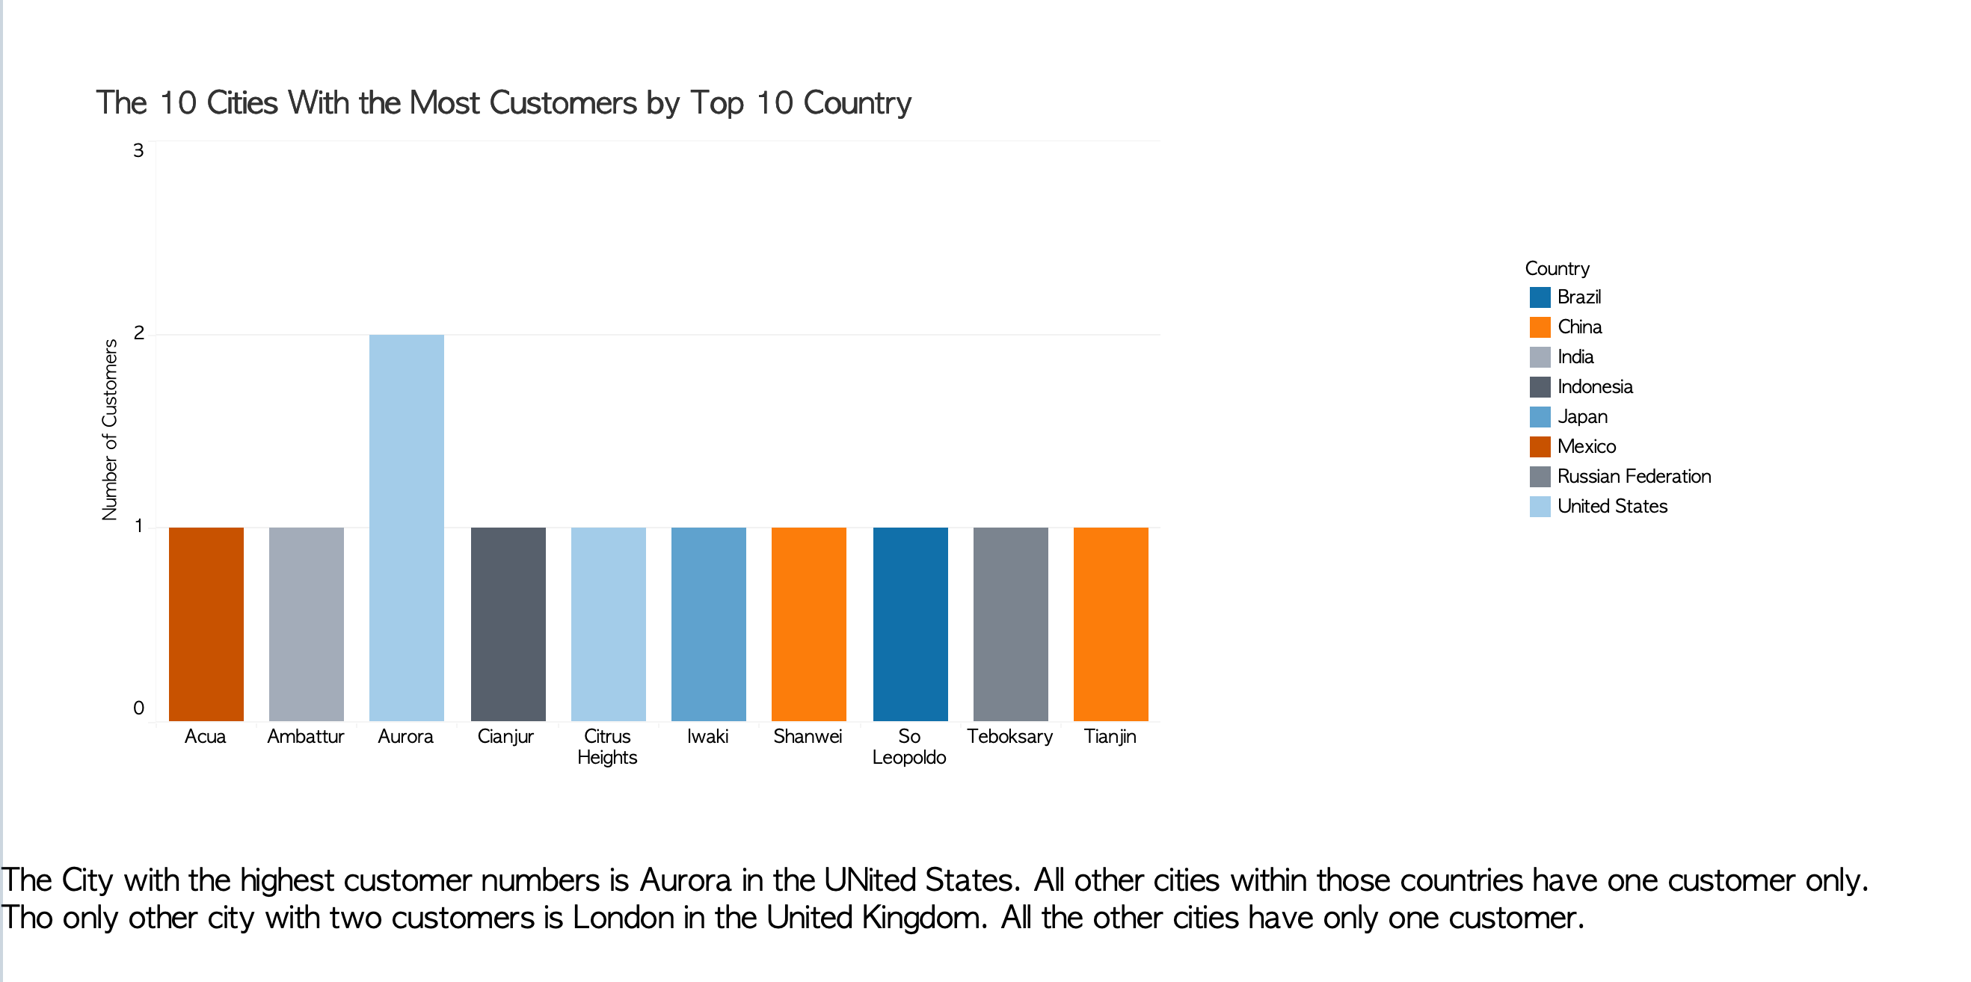


Which Cities Within those Countries have the Highest Customer Numbers
Which Cities Within those Countries have the Highest Customer Numbers
?

Slide 8
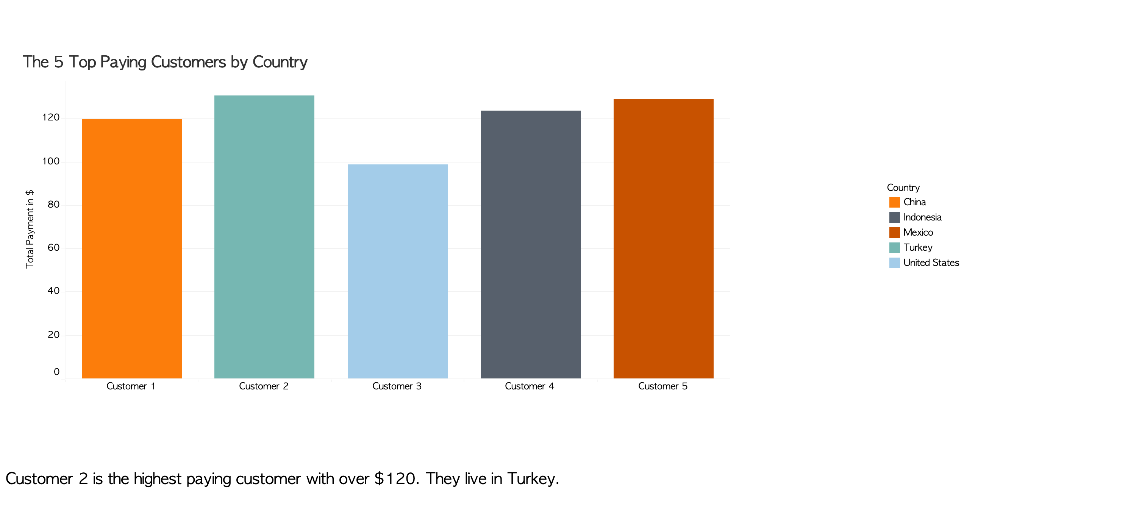
Where do the Customers Live who Pay the Most?

Slide 9
Results
Rockbuster has the most customers in India, China and the United States.
Rockbuster’s highest paying customers live in Turkey, Mexico and Indonesia.
Fimls are usually rented for at least 3 days but no longer than 7.

Slide 10
Recommendations
Expand those markets where the most customers live.
Offer special deals for films which are returned within 3 days.
Further Research needed
Those countries with the most customers are also big countries, therefor other countries might be a better target for marketing if a higher percentage of the population is a customer of Rockbuster’s.
More analysis into revenue is needed. So far it is only known where the highest paying customers live, but not which country produces the highest revenue.

Slide 11
Resources
https://public.tableau.com/views/3_20TASK/Dashboard1?:language=en-GB&:sid=&:redirect=auth&:display_count=n&:origin=viz_share_link
https://public.tableau.com/views/3_10TASK2/Dashboard1?:language=en-GB&:sid=&:redirect=auth&:display_count=n&:origin=viz_share_link
https://public.tableau.com/views/3_10Task3/Dashboard1?:language=en-GB&:sid=&:redirect=auth&:display_count=n&:origin=viz_share_link

